Slide 1
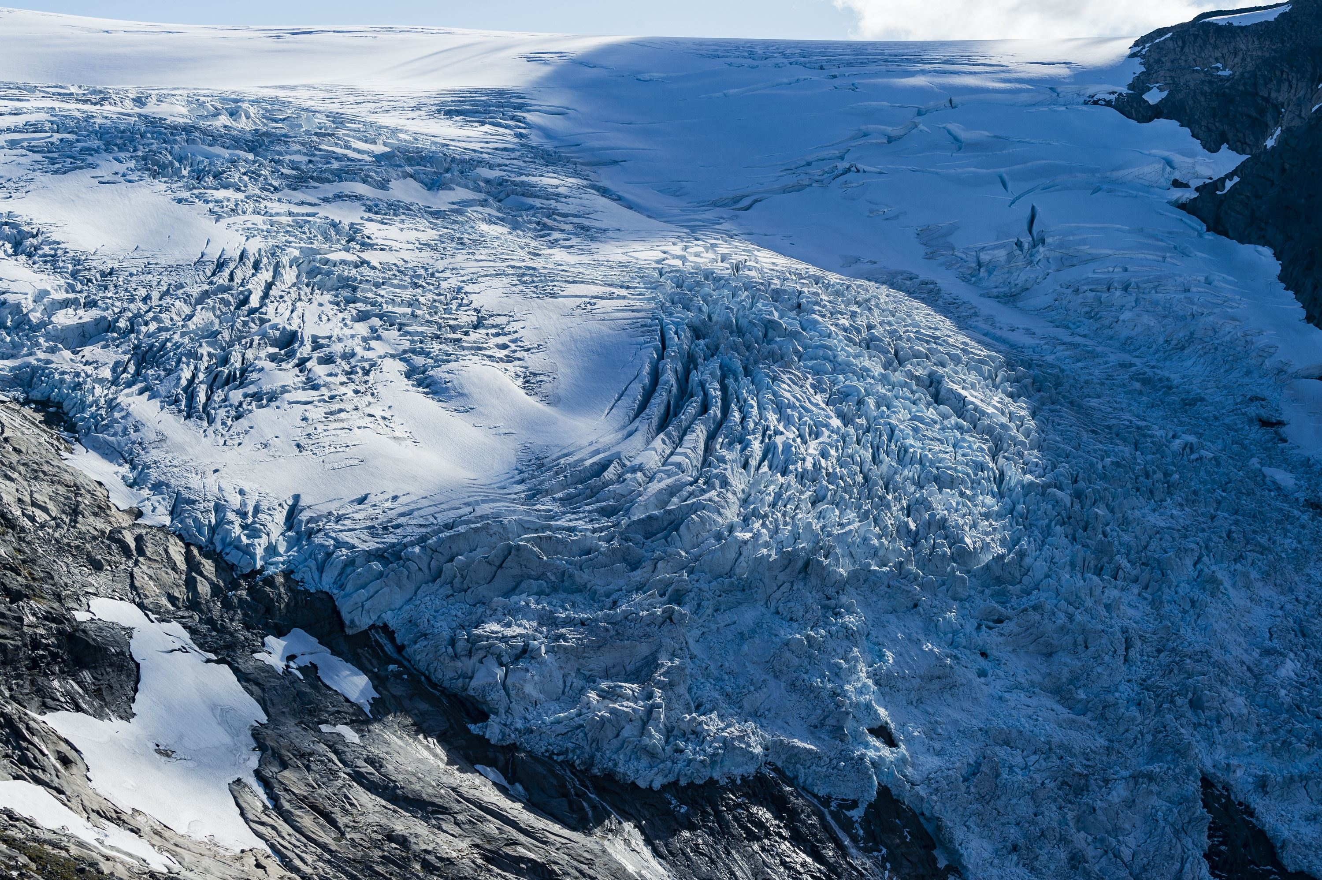


Physics-based machine learning for glacier modelling
Jordi Bolibar
Facundo Sapienza

Slide 2
1/3 Modelling the glacier system
Samuel Birmann

Slide 3
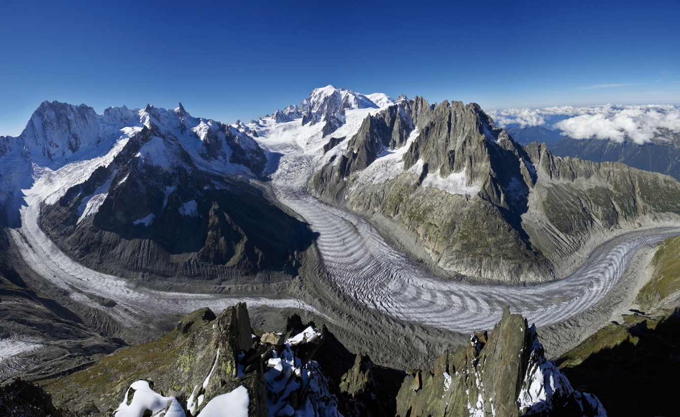
The glacier system
Glacier modelling
1/3
Mer de Glace, Mont-Blanc (France)
Accumulation
Climate
Mass balance
Ice dynamics
Ablation
Glacier evolution model
© JF Hagenmuller

Slide 4
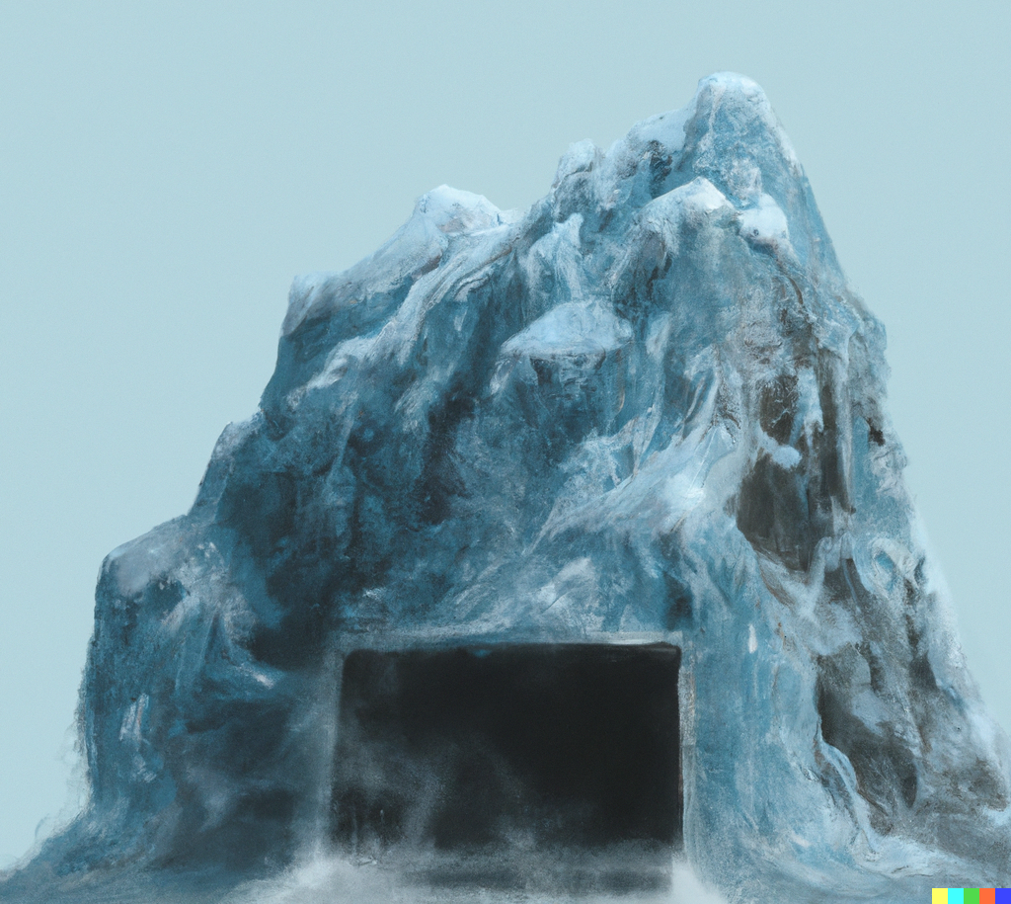
Glacier evolution models
Glacier modelling
1/3
Mass balance component
Ablation
Accumulation
Refreezing
Debris cover
…
Ice dynamics component
Creep
Basal sliding
Calving
…
Analytical form
Empirical
Parameterized
Process-based
Physics-based
Statistical – Machine learning
Differential equations

Slide 5


Local vs Global glacier modelling
Glacier modelling
1/3
Local modelling (1-10 glaciers)
More complex models can be used (e.g. Full Stokes)
Model parameters can be fine tuned manually
Regional to Global modelling (100s-200,000 glaciers)
Computational cost needs to be taken into account by using simplifications (e.g. Δh, SIA, flowline…)
Model parameters need automation based on optimization
Model complexity vs capacity (flexibility)

Slide 6
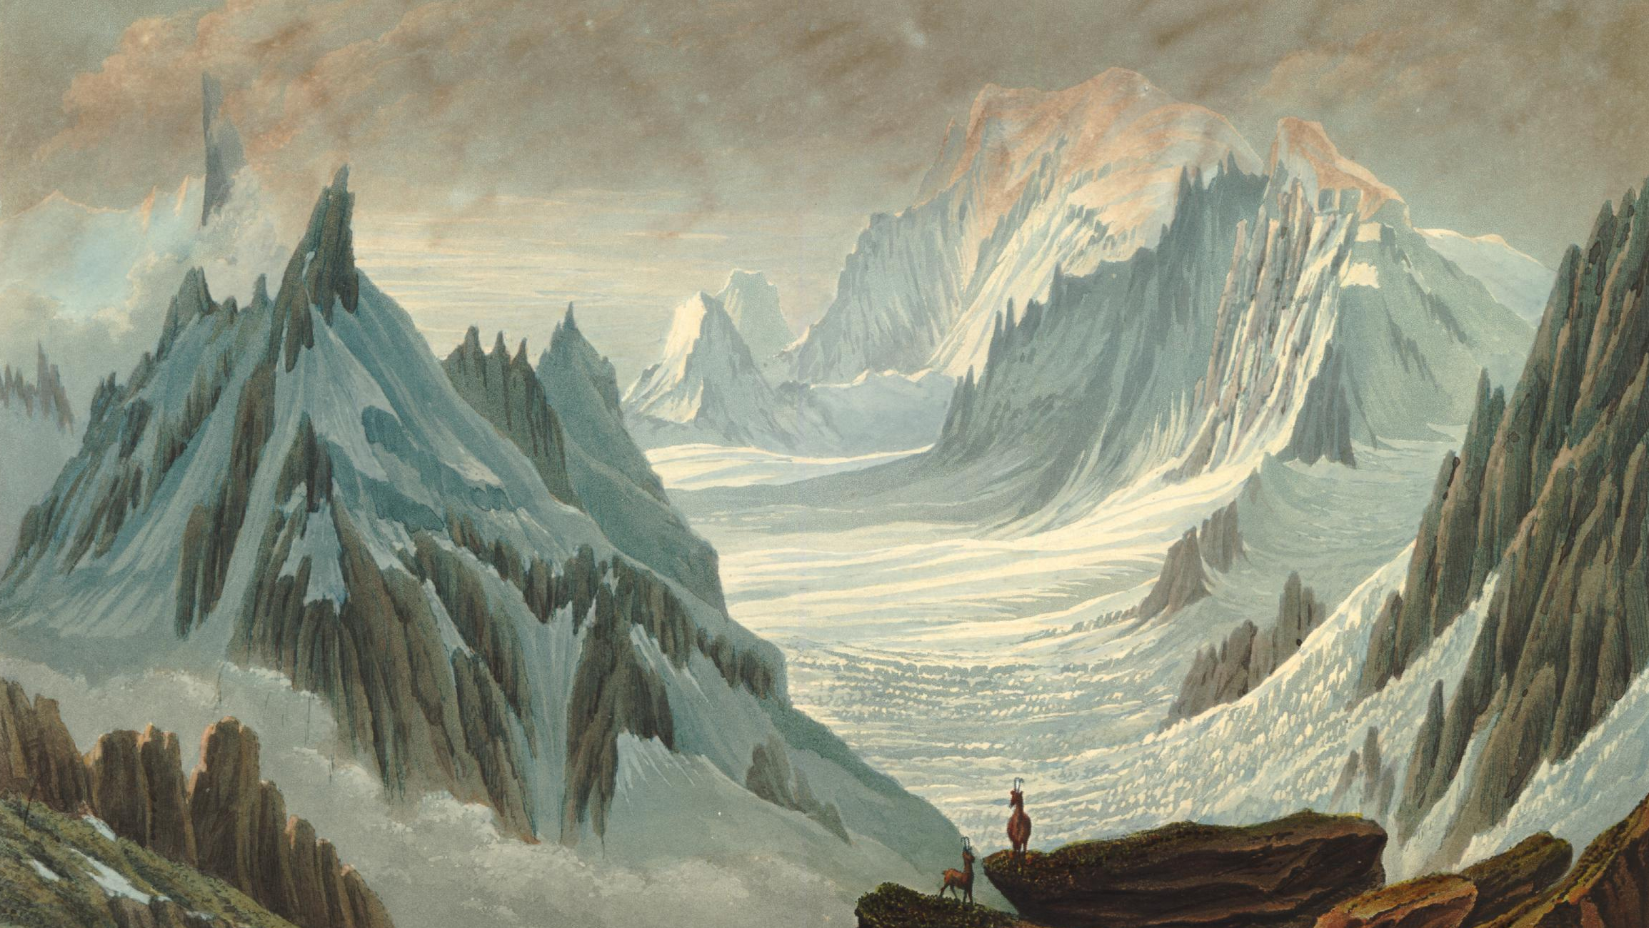
2/3 Physics-based machine learning
Samuel Birmann

Slide 7

Machine learning pipelines
Physics-based ML
2/3

Slide 8

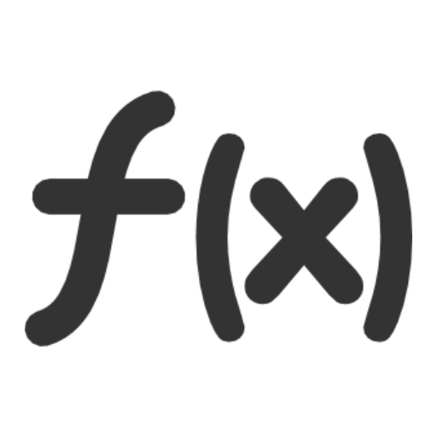


Machine learning pipelines
Physics-based ML
2/3
Split X and Y into train, validation and test datasets,
where X is the feature matrix and Y is the target variable
Train parameters of model M to learn a function f such as Y = f(X)
Tune hyperparameters which determine model M using the train and validation datasets
Assess final model performance on independent test dataset

Slide 9
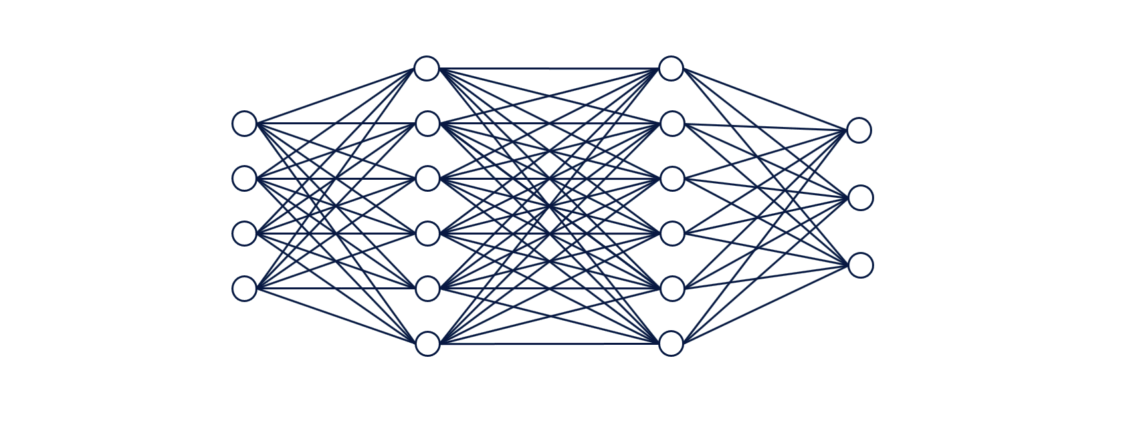
Neural networks in a nutshell
Physics-based ML
2/3
Feed-forward neural network
Compute loss
Backpropagation
Weights
Activation function

Slide 10
Regression for physical processes
Physics-based ML
2/3
Modelling physical processes implies a series of challenges:
How can we be sure that we are respecting basic physical properties? Feature selection, Physical constraints
How can we be sure that we are modelling the actual physical process? Testing and validation, Physical interpretation
What are the limitations in the model design and its predictions? Training strategies, Spatiotemporal resolution

Slide 11
Regression for physical processes
Physics-based ML
2/3
Modelling physical processes implies a series of challenges:
How can we be sure that we are respecting basic physical properties? Feature selection, Physical constraints
How can we be sure that we are modelling the actual physical process? Testing and validation, Physical interpretation
What are the limitations in the model design and its predictions? Training strategies, Spatiotemporal resolution

Slide 12


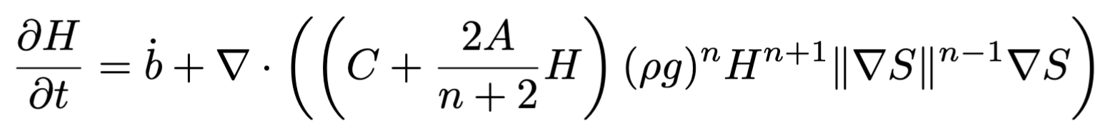
1. Respecting physics
Physics-based ML
2/3
Good domain knowledge in the physics involved. Make sure the chosen features are relevant to the process.
Literature review
Model design
Review physical equations

Slide 13
1. Respecting physics
Physics-based ML
2/3
Add physical constraints in the model design:
Physics-based learning
3 main categories:
Data-driven: classic ML
Physical losses: Physics-informed Neural Networks (PINNs)
Universal Differential Equations: differentiable programming + solvers + neural networks
Physics-Based Deep Learning,
Thuerey et al. (2021)

Slide 14
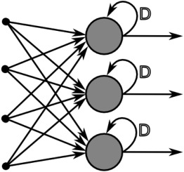
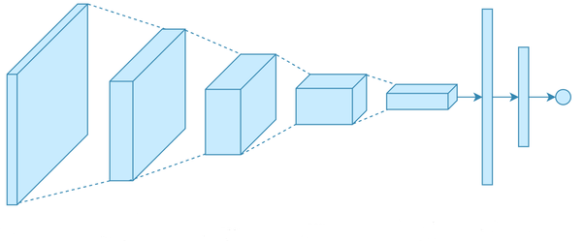
1. Respecting physics
Physics-based ML
2/3
a. Data-driven:
Applicable to any type of regression method
Output: constrain within physically plausible values
Loss function: choose one that suits the target data
For neural networks: choose an architecture that matches the nature of the dataset
Recurrent NNs for time dependencies
Convolutional NNs for spatial dependencies

Slide 15
1. Respecting physics
Physics-based ML
2/3
a. Data-driven:
Advantages:
Straightforward model design
Flexibility: great for physical processes for which we don’t have much previous knowledge
Data exploration: great way to explore a novel dataset to obtain a first model to learn from the data
Disadvantages:
Requires more verifications to make sure physical properties are respected
General lack of interpretability

Slide 16
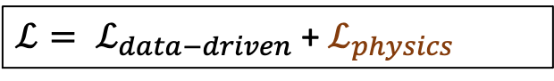
1. Respecting physics
Physics-based ML
2/3
b. Physics-informed Neural Networks:
Physical (soft) constraints are added in the NNs loss function
Differential equation
NN learns the solution of the differential equation
Additional tricks can be used for training
Custom activation functions
NN parameter initialization
$ℒ= ℒ_{data−driven}$ + $ℒ_{physics}$

Slide 17
1. Respecting physics
Physics-based ML
2/3
b. Physics-informed Neural Networks:
Advantages:
Physical constraints: the model can reliably respect the imposed physical conditions
Very fast to execute once trained
Disadvantages:
Very hard to train
High computational cost for training: needs to learn the numerical solver and/or the “classic” regression

Slide 18


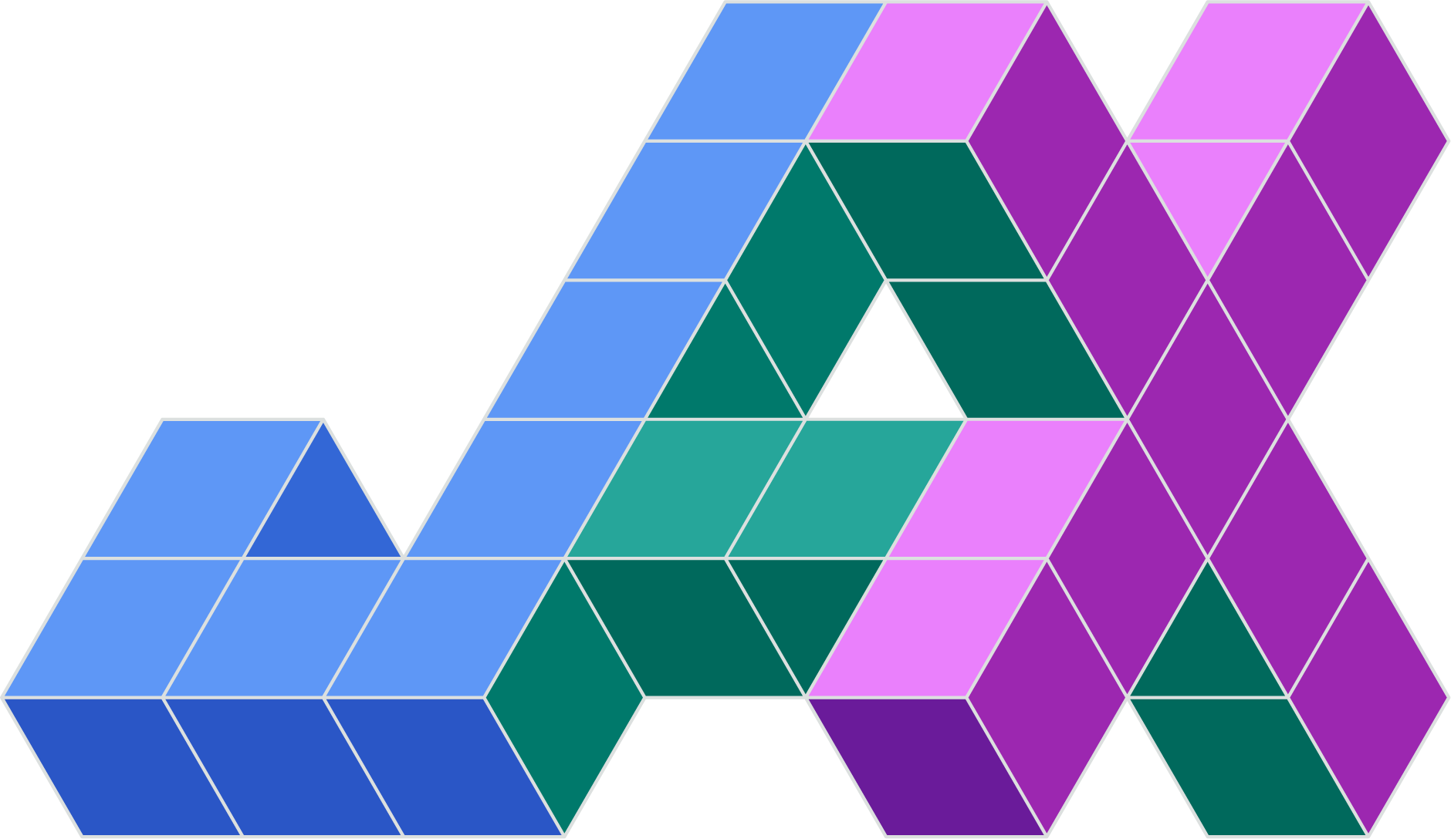

1. Respecting physics
Physics-based ML
2/3
c. Neural/Universal Differential Equations:
Combine numerical solvers with neural networks (hard constraints)
Requires a good automatic differentiation (AD) framework:
The model needs to be fully differentiable!
They can tackle more complex inverse problems:
New opportunities for discovering
physical laws/parameterizations
New modelling philosphy:
Make use of as much existing knowledge as possible
ONLY use regressors (e.g. machine learning) for what you DON’T know

Slide 19
1. Respecting physics
Physics-based ML
2/3
c. Neural/Universal Differential Equations :
Advantages:
Targeted ML approach, compatible with small data
Faster and easier to train than PINNs
Functional inversions: new tool to discover physical/empirical laws
Disadvantages:
More technically complex to implement: requires a good AD framework
Generally slower to execute than PINNs and data-driven ML models

Slide 20
Regression for physical processes
Physics-based ML
2/3
Modelling physical processes implies a series of challenges:
How can we be sure that we are respecting basic physical properties? Feature selection, Physical constraints
How can we be sure that we are modelling the actual physical process? Testing and validation, Physical interpretation
What are the limitations in the model design and its predictions? Training strategies, Spatiotemporal resolution

Slide 21
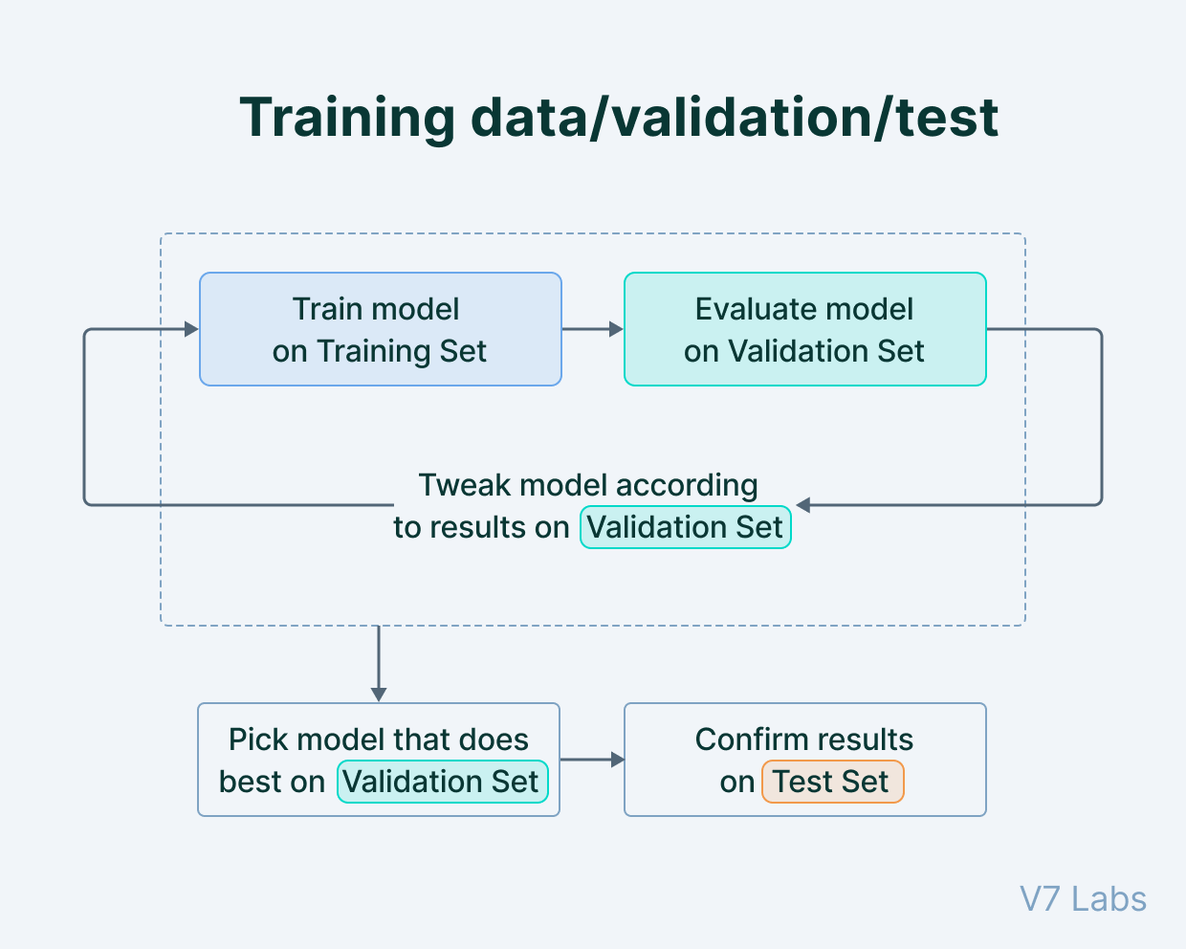
2. Trustworthy models
Physics-based ML
2/3
A robust validation and test pipeline is the best way to make sure we are learning useful information.
Using an independent well-chosen test dataset will help identify if the model has any pathologies.

Slide 22
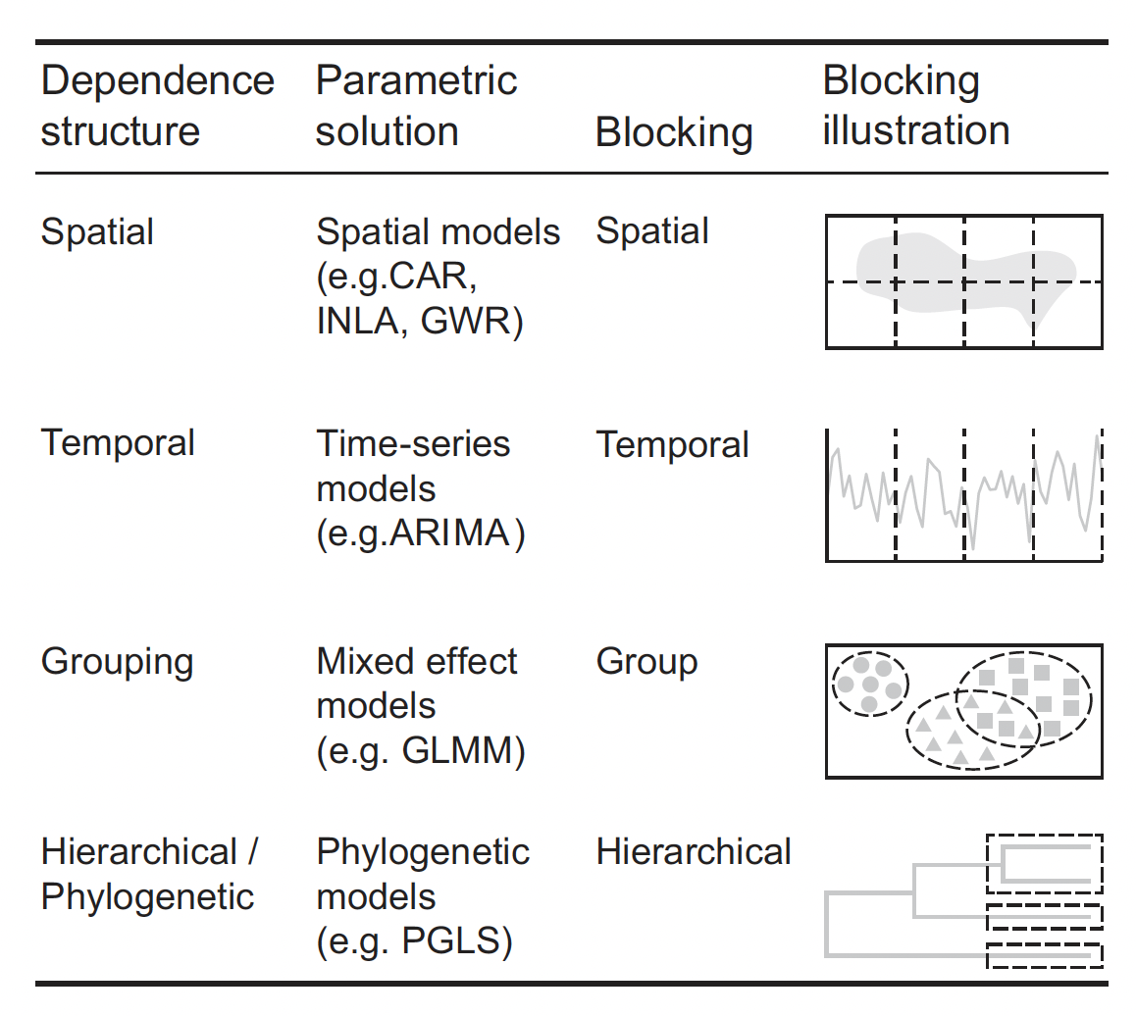
2. Trustworthy models
Physics-based ML
2/3
The division into train, validation and test needs to respect spatiotemporal structures in the data (e.g. glaciers, regions, years…)
Roberts et al. (2017)

Slide 23

2. Trustworthy models
Physics-based ML
2/3
Years
Block cross-validation
Leave-One-Glacier-Out (LOGO)
Leave-One-Year-Out (LOYO)
Leave-Some-Years-and-Glaciers-Out
(LSYGO)
Fine tuning
Monitoring performance on different folds
Adjusting hyperparameters
Topography
Glaciers
Climate
Train
Validation

Slide 24
2. Trustworthy models
Physics-based ML
2/3
Once hyperparameters are chosen: train on full training dataset and assess model performance on test dataset.
Cross-validation ensemble approach
N
LOGO
LOYO
LSYGO
1 set of parameters per fold = N CV models

Slide 25
Regression for physical processes
Physics-based ML
2/3
Modelling physical processes implies a series of challenges:
How can we be sure that we are respecting basic physical properties? Feature selection, Physical constraints
How can we be sure that we are modelling the actual physical process? Testing and validation, Physical interpretation
What are the limitations in the model design and its predictions? Training strategies, Spatiotemporal resolution

Slide 26
3. Being mindful about model limitations
Physics-based ML
2/3
It is crucial to understand how the model has been designed and what its strengths and weaknesses are
Spatiotemporal
data resolution
Acceptable applications
Validation/test and
cross-validation strategy
Spatial or temporal domain generalization
Data quality and coverage
Uncertainty and error interpretation

Slide 27
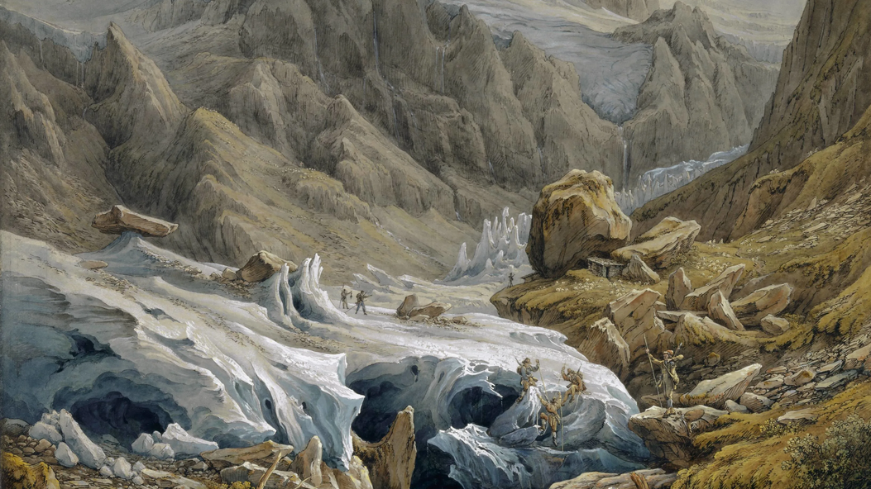
3/3 Project description
Samuel Birmann

Slide 28

Machine learning for mass balance modelling
Physics-based ML
2/3
Main goal:
Explore different regression methods and learn the fundamentals of a machine learning pipeline, applied to glacier mass balance modelling.
Secondary goals:
Explore ways to improve model performance
Understand the limitations of the model(s)
Find ways to integrate these ideas into your own research projects

Slide 29
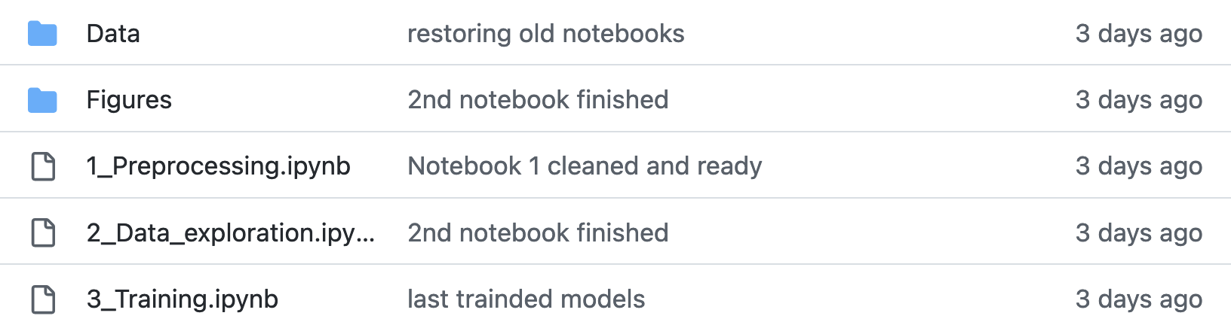
Machine learning for mass balance modelling
Physics-based ML
2/3
Follow the tutorials from the following Jupyter notebooks:
https://github.com/Machine-Learning-in-Glaciology-Workshop/Project_MB_Regression

Slide 30
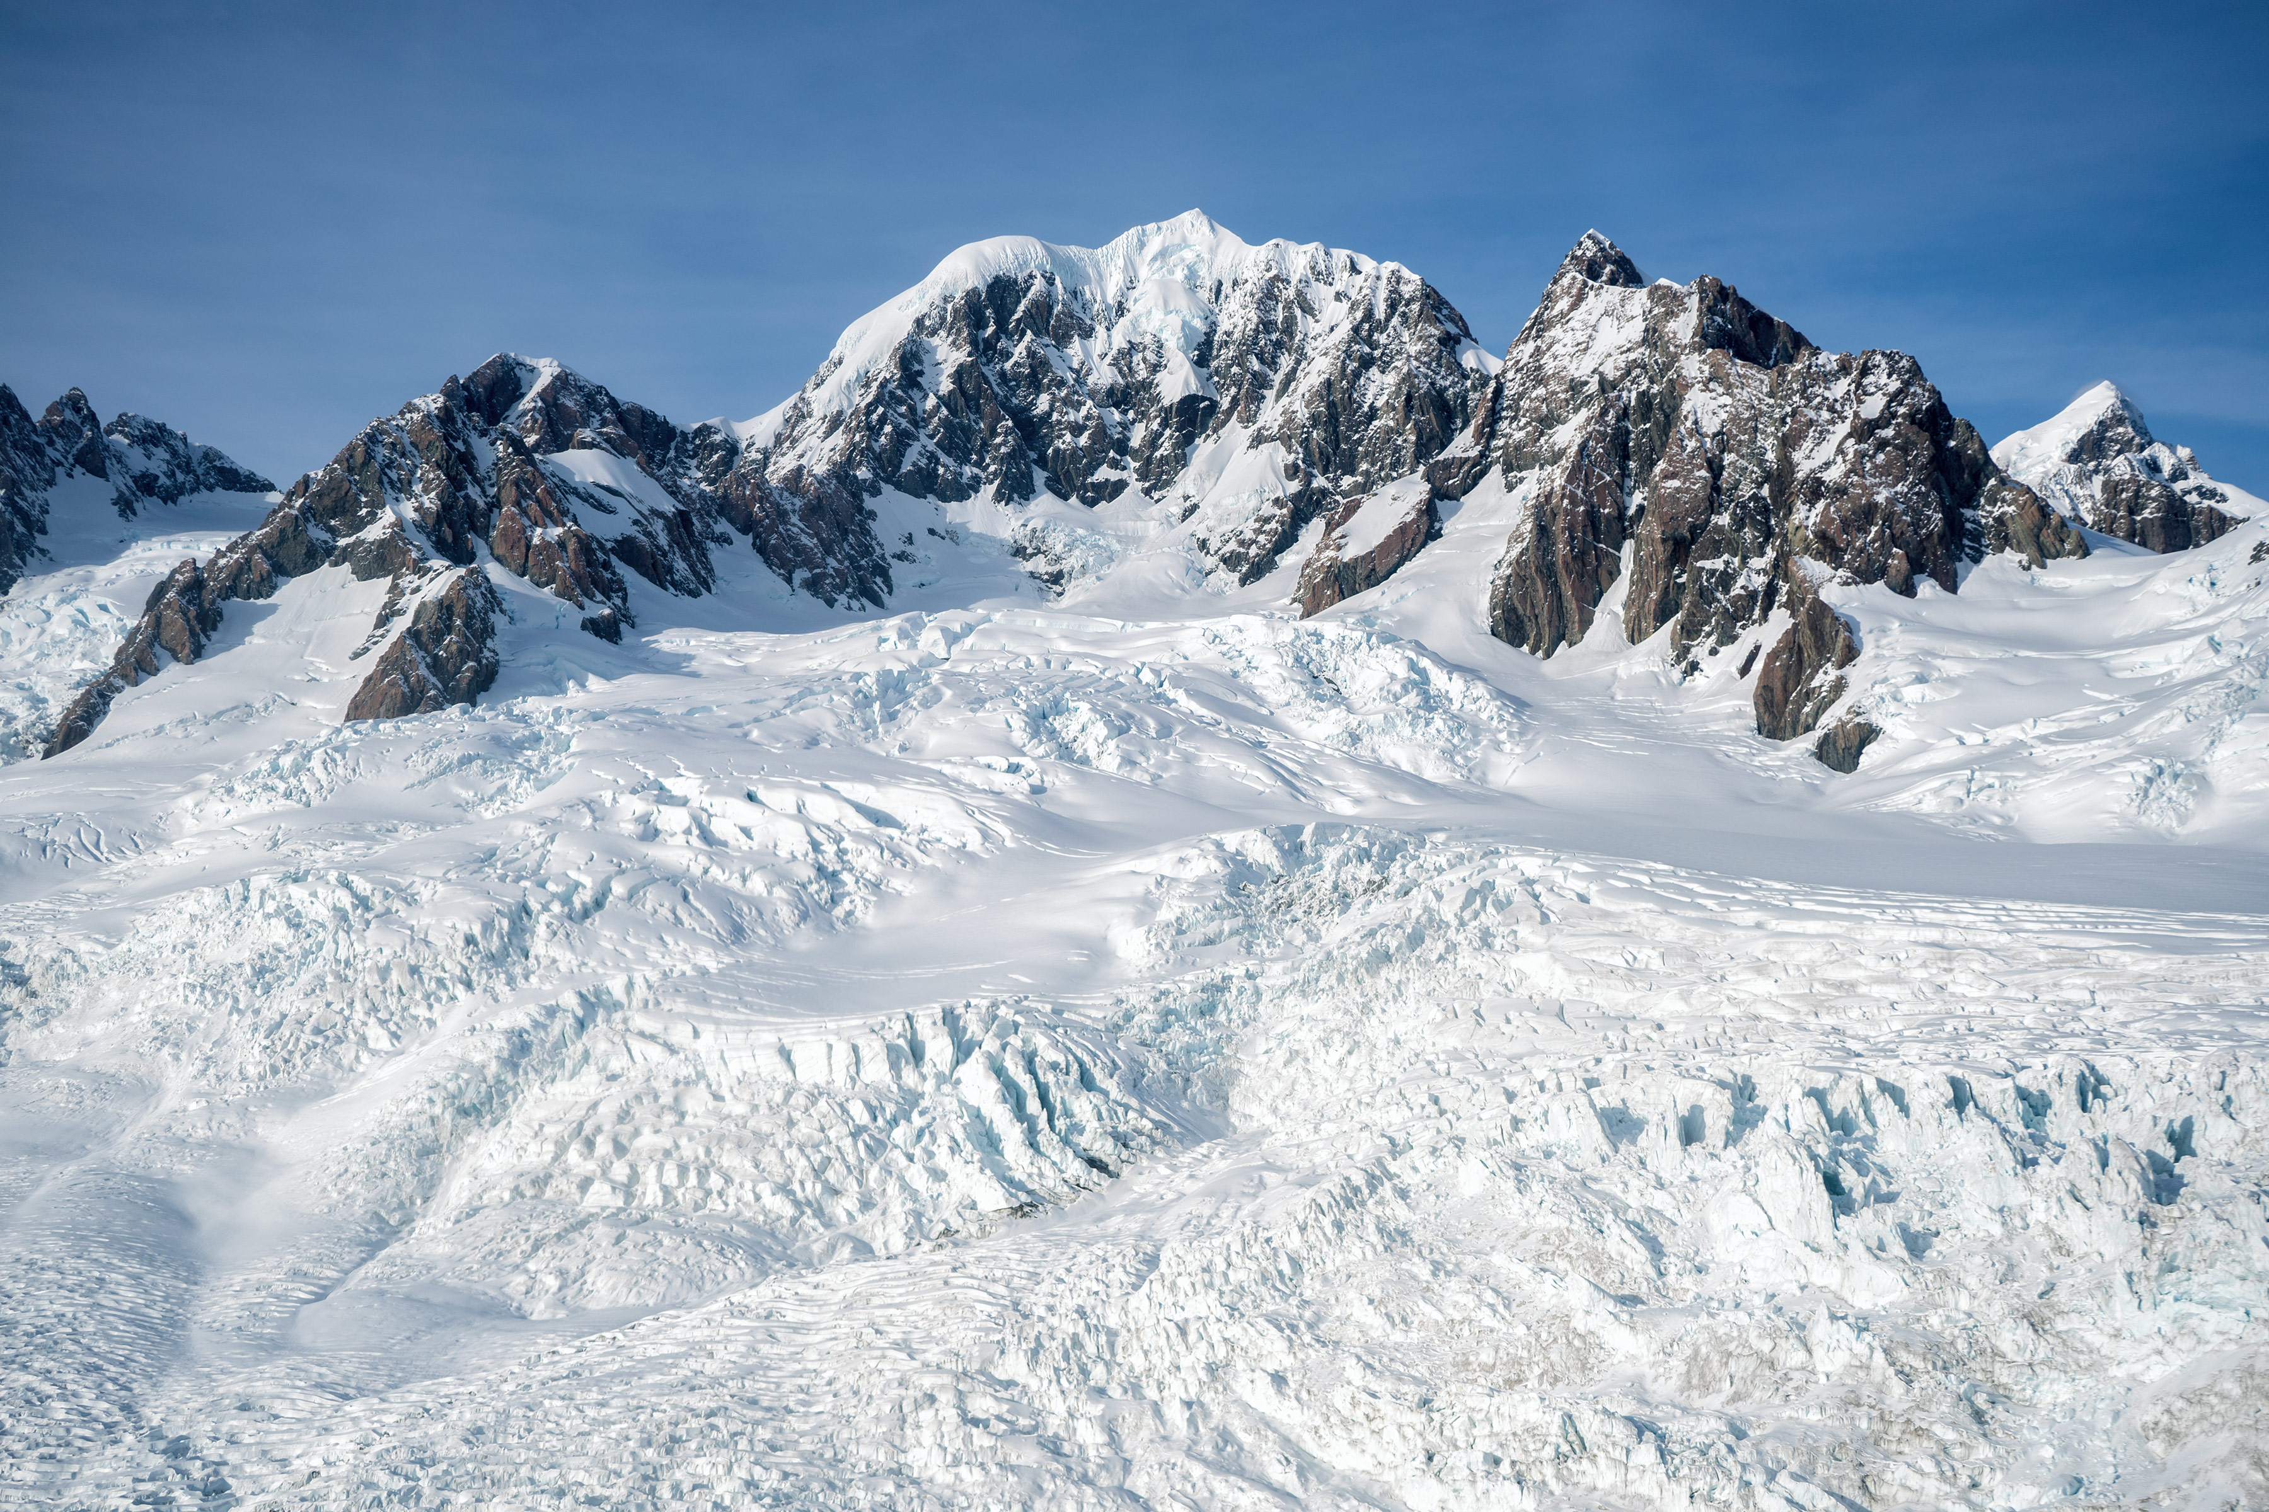


Thank you for your attention
@
@JordiBolibar
@ODINN_SciML
@fsapienza21
@jordi_bolibar
@SapienzaFacu
@ODINN_org
j.bolibar@uu.nl
fsapienza@berkeley.edu
© Tom Bernardo
© NASA

